Slide 1
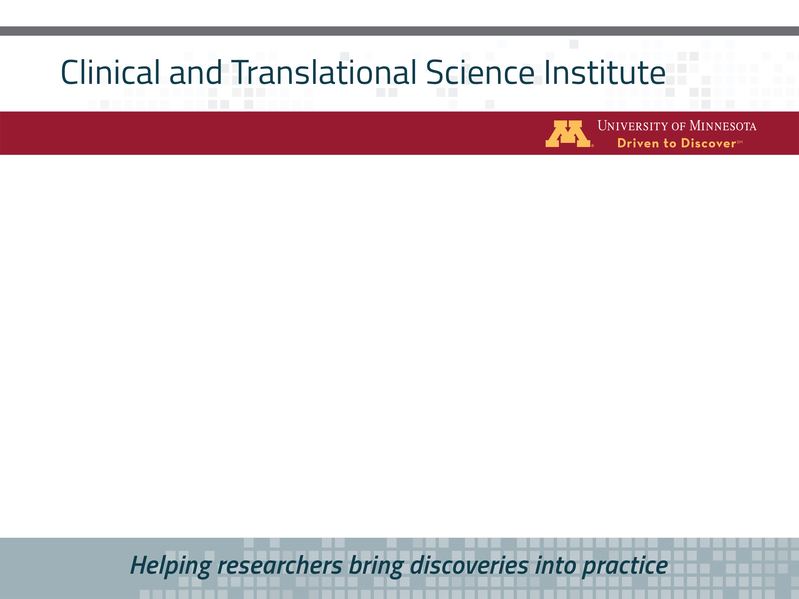
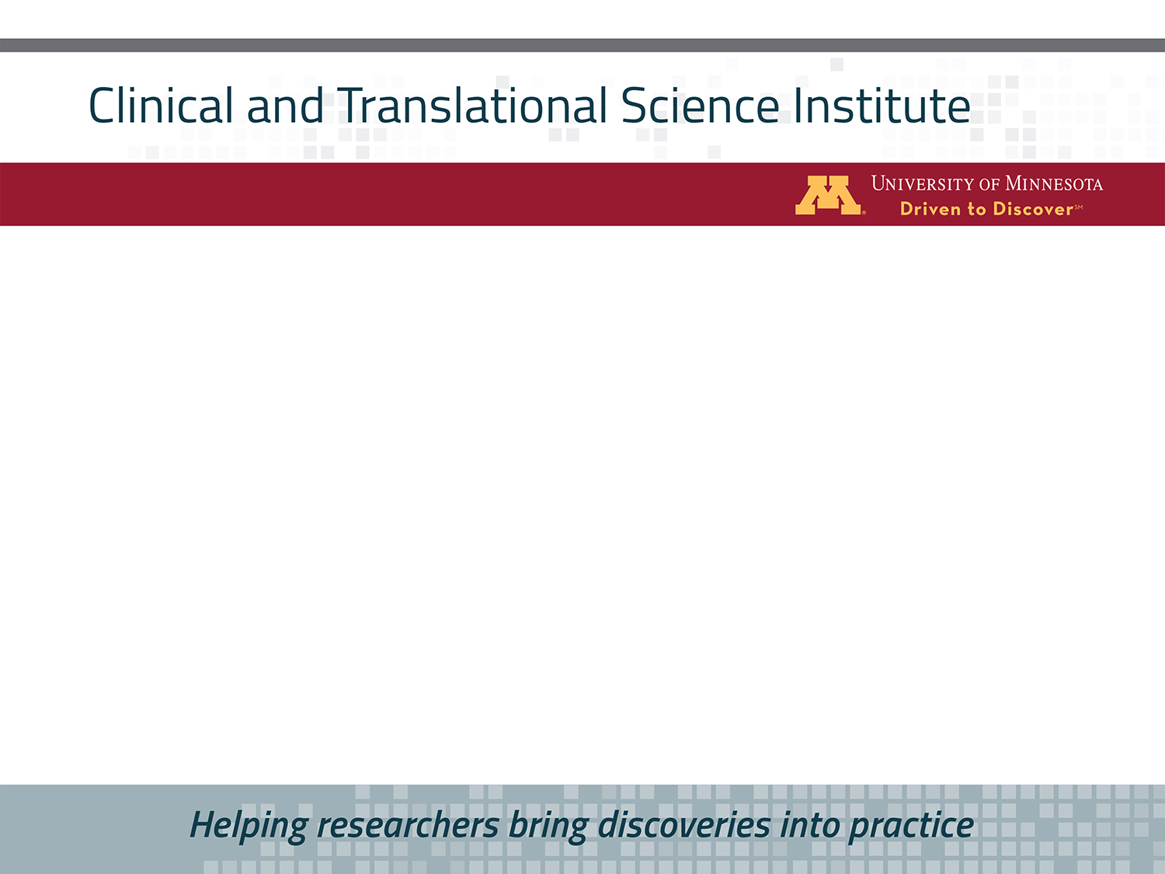





Innovations in Wastewater Treatment for Small Communities
Dr. Sara Heger
Legislative Subcommittee on MN Water Policy
September 17, 2020

Slide 2
Water Resources Center, Onsite Sewage Treatment Program (OSTP)
Education for Professionals started in 1974
Education for Homeowners & Small Communities started in early 1990s
Ongoing research and demonstration supporting educational efforts

Slide 3
Presentation overview
What is the scale and size of issue?
Challenges with wastewater treatment in small communities
Current UMN related activities
What is needed to help move more of these communities forward?
Notes:
They are looking for information on innovative wastewater treatment for small cities (<5,000 people), including an overview of current research, economics/costs, and what they (the legislature) could do to move things forward.

Slide 4
Size and scale of the issue

Slide 5
Scale of the issue - regulations
Wastewater treatment plants (WWTP) all have MPCA permits
Subsurface sewage treatment systems (SSTS) over 10,000 gpd (around 30 homes) have a MPCA permit
SSTS <10,000 gpd have a county permit
  Regulatory requirements increase at 2,500 and 5,000 gpd

Slide 6
Scale of the issue <5,000 people
Communities with a WWTP that is undersized or outdated
  Typically larger in scale
  May have future issues with phosphorous, chloride or nitrogen
Communities without wastewater treatment
  Smaller in scale
  May be directly discharging untreated wastewater or have outdated SSTS
  “Unsewered”

Slide 7
Size of the issue - MPCA survey of unsewered communities
All 87 counties reported
  1282 areas of concern across the state
    5 or more homes within a ½ mile
    In the last two years, LGU’s have eliminated 147
  MPCA priority ranked listed areas
    Imminent public health threat (surfacing of effluent)
    Failing
Notes:
The first area is the continued struggle of small communities that lack basic wastewater treatment infrastructure – either individual SSTS or a community system that provides treatment, not just disposal.
Over the last several years, the PCA has partnered with all 87 counties and roughly half of the LGU’s to inventory the number of unsewered areas throughout the state and begin assessing the needs in these areas. Collectively, the counties listed 1282 areas of concern across the state. The Agency ha initially focused on those areas that may potentially have IPHT risks. These areas included communities with straight-pipe collection systems, individual straight pipes, and those with surfacing issues. All known community straight pipes systems have been addressed or are currently being worked on. We are still working on other areas with potential surfacing concerns and/or individual straight-pipe systems.

Slide 8
Unsewered communities
Some areas are incorporated communities
  In a better place to obtain a community solution
  More opportunity for state grants
Unincorporated communities
  Not organized
  Individual fixes
  Very little grant money available
Notes:
** Map is the unsewered areas mapped out per county

Slide 9
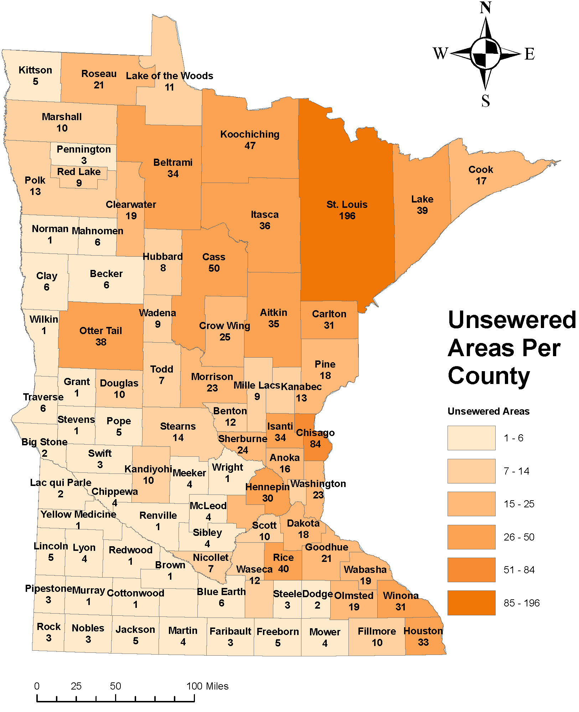
10/1/18

Slide 10
Challenges in small communities

Slide 11
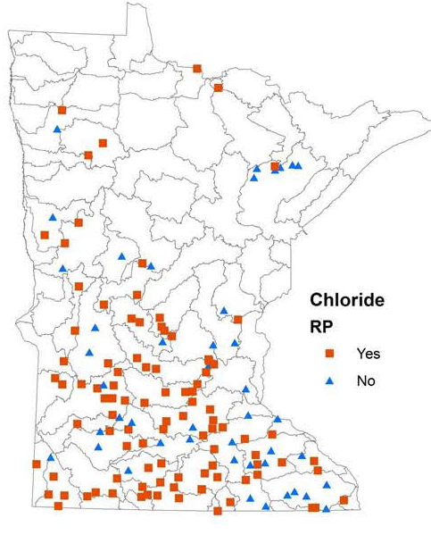
WWTP with reasonable potential (RP) for having a chloride limit
100 municipal WWTP will eventually need a chloride effluent limit in their permit
About 20 already have a limit

Slide 12
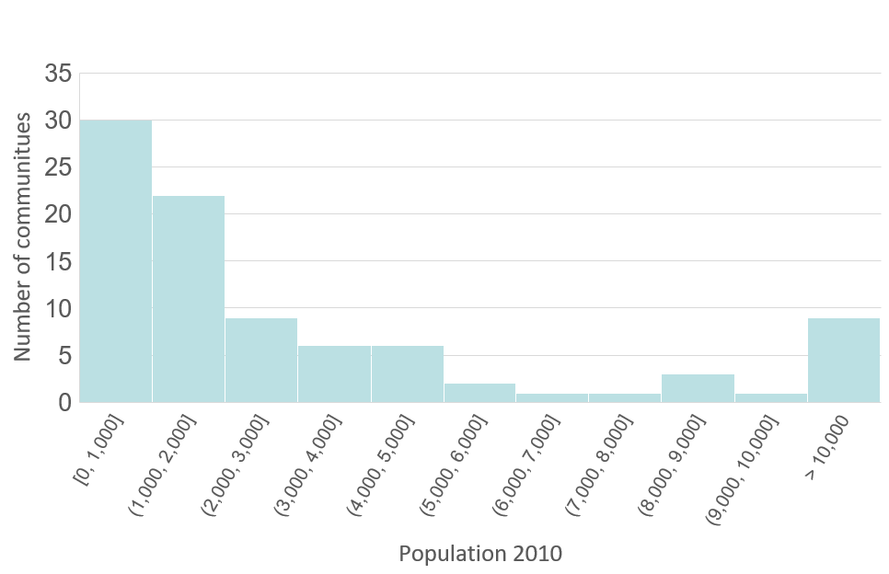
Population of communities with chloride RP
Under 5,000 = 73 communities

Slide 13
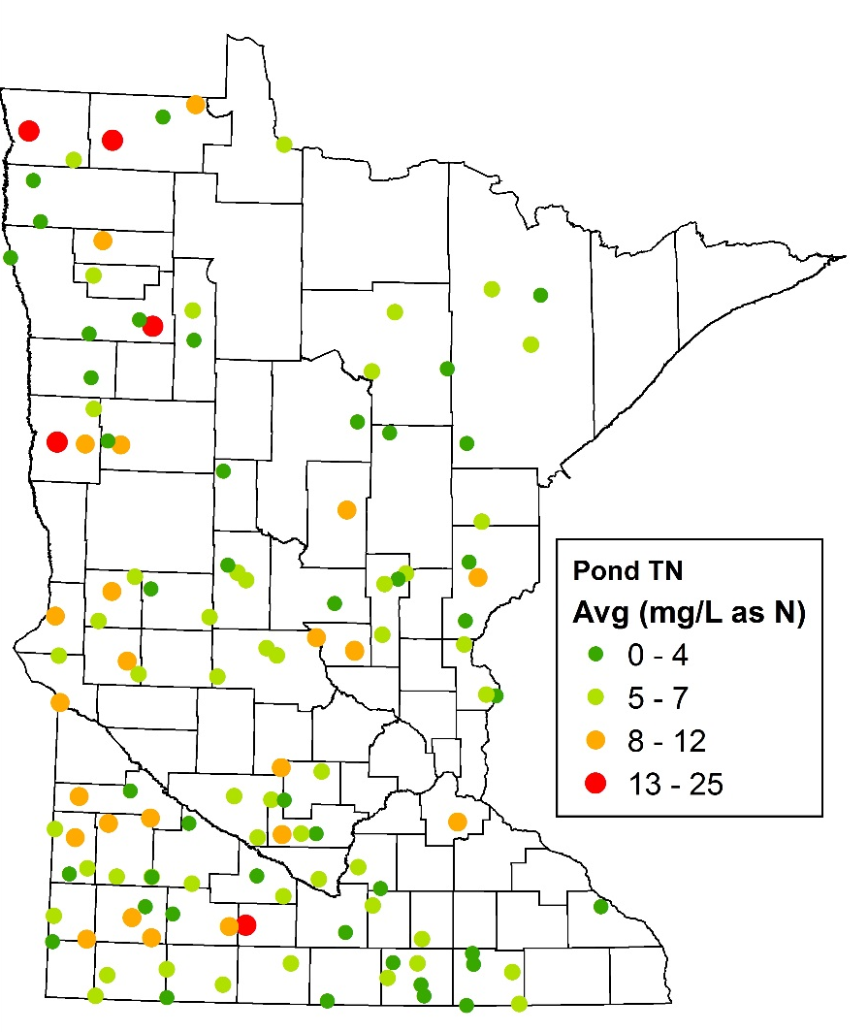

Nitrogen issues
>300 pond systems in operation
23% of ponds not effective in nitrogen removal
To date they do not have a total nitrogen removal limit, just ammonia
Dark green dots = excellent performance
Red and orange dots = poor performance

Slide 14
Phosphorus issues
500 small WWTP in Minnesota
225 currently have a phosphorus limit
~100 will get a limit upon permit renewal over next 5 years

Slide 15
Affordability issues - wastewater costs by community size

Slide 16
Current UMN activities

Slide 17
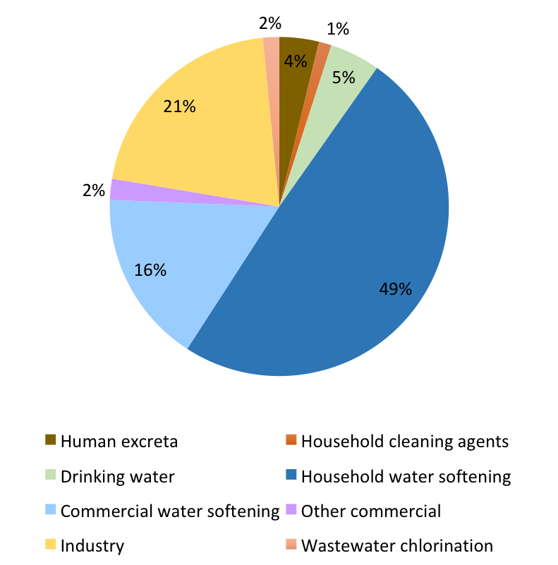
1. LCCMR Completed Project: Chloride sources across all WWTP
Water softening contributes 65% of WWTP chloride
Industry also high chloride source (21%)
Notes:
Road salt infiltration not estimated for WWTPs without monitoring data

Slide 18
2. WERF Completed Project - projecting costs of community scale wastewater
This project developed software that contains:
  Spreadsheet-based economic model and
  Contains fact-sheet style educational modules
The tool provides users with fundamental information about:
  Operation of various wastewater management options and
  Cost estimates for these options based on local cost indices

Slide 19
3. LCCMR-FUNDED RESEARCH STARTED JULY 2019
Understand why ponds underperform so that nitrogen removal can be improved
Understand how nitrogen
is removed in these systems
Develop simple methods to improve nitrogen removal

Slide 20
Past small community wastewater activities
OSTP worked with over 20 Minnesota small communities
Education and facilitation provided on:
  Wastewater treatment basics
  The decision-making process
  Working with professionals
  Treatment options
  Management of systems
Notes:
Due to lack of support these activates have stopped

Slide 21
OSTP community involvement
Amelund
Andyville
Barry
Biscay
Blueberry Twp.
Bixby
Carlos
Crane Lake
Dakota
Doran
Forest City Twp.
Hazel Run
Hiawatha Beach in Ham Lake
Jenkins
Larsmont
Leonard
Louisburg
McGrath
Myrtle
Nicolville
Rolling Shores
Side Lake
Trotsky

Slide 22
What is needed?

Slide 23

MNDRIVE: environment programing goals
A Listening Session series with a focus on rural water and wastewater issues will be held this academic year

Slide 24
Economic issues – hierarchy needed
Community needs a good process to come up with the most economical solution
Replacement costs vary from $8 - $30K+
Will individual SSTS work?
Will a cluster SSTS work?
Can they regionalize?

Slide 25
What is needed - technical
Further research into reduction of nitrogen, phosphorus and chloride
More technical options and potentially regulatory changes related to state permitting

Slide 26
What is needed - assistance
Many of communities have no staff and limited planning funds
Funding mechanisms for un-incorporated communities
More than money
  Facilitation
  Advocacy
  Technical support
  Management considerations

Slide 27
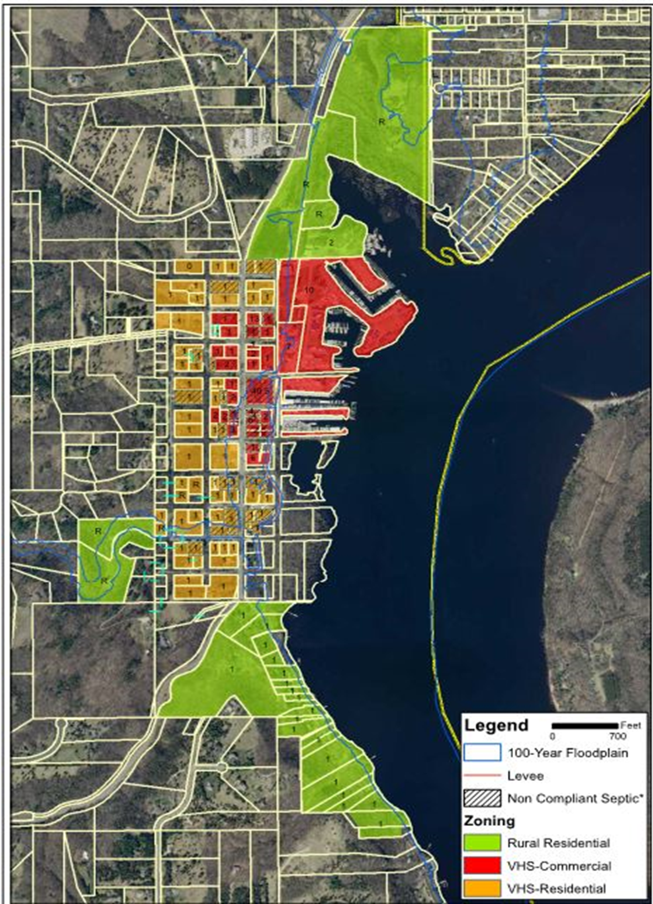
Example – Afton, MN
Downtown Afton
  77 residential
  25 commercial
  Conventional gravity collection
Largest SSTS in MN
Design flow = 50,550 gpd

Slide 28
Questions and discussion
Dr. Sara Heger
sheger@umn.edu

